Slide 1



Cryptex
Cryptex is the easiest, safest, and fastest way to buy & sell crypto asset exchange. It is supervised by M. Daoud and made by Zaghi Amine.
Supervised by
Made by
M. Daoud
Zaghi Amine

Slide 2


Definition
1
Cryptex
Cryptex is the easiest, safest, and fastest way to buy & sell crypto asset exchange.

Slide 3
Tools Used
HTML
CSS
Bootstrap
Hypertext Markup Language
Cascading Style Sheets
Front end Framework

Slide 4


Application

Slide 5

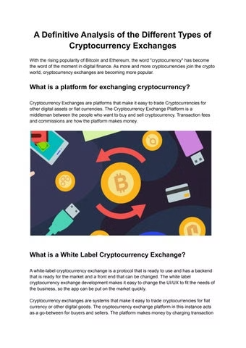
Conclusion
Cryptex is the easiest, safest, and fastest way to buy & sell crypto asset exchange.

